Slide 1

CS 360 Programming Languages Day 8

Slide 3
Review
A first-class citizen is a data type that can be
Passed as an argument to a function.
Returned as a value from a function.
Assigned to a variable.
(Stored in a data structure.)
(Created at run-time [dynamically, on-the-fly])
First three are always part of the definition; last two sometimes.

Slide 4
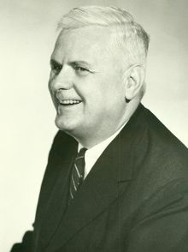
Review
Lambda expression: creates and returns an anonymous function.
(lambda (arg1 arg2 ...) expression) Term comes from the lambda calculus.
Developed by Alonzo Church.
A formal way of studying the properties of computation, like Turing machines.

Slide 5
Review
Higher order functions:
Take functions as arguments, or
Return functions.
Map and filter both take functions as arguments.
Map: Applies a function to every (top-level) item within a list. (map func lst)
Filter: Takes a list L and a predicate P; returns a list of all the values in L that satisfy P. (filter pred lst)

Slide 6
Map examples
(define (map func lst) (if (null? lst) '() (cons (func (car lst)) (map func (cdr lst)))))
(define (double x) (* x 2))
(map double '(1 2 3)) => '(2 4 6)
(map (lambda (x) (* x 2)) '(1 2 3)) => '(2 4 6)
(map car '((1 2 3) (4 5) (6) (7 8 9))) => '(1 4 6 7)
(define (scale factor lst) (map (lambda (x) (* x factor)) lst) (scale 2 '(1 2 3)) => '(2 4 6)

Slide 7
Map examples
(map (lambda (x) (+ x 1)) '(1 2 3)) => ?
(map (lambda (x) (cons x '()) '(1 2 3)) => ?
(map (lambda (x) (list x)) '(1 2 3)) => ?
(map (lambda (x) (if (> x 0) (* x 2) (* x 3))) '(1 -2 -3 4))
Key to using map with lambda expression: the argument to the lambda expression (x) represents each element of the list in turn.

Slide 8
Filter examples
(define (filter func lst) (cond ((null? lst) '() ((func (car lst)) (cons (func (car lst)) (filter func (cdr lst)))) (#t (filter func (cdr lst)))))
(filter odd? '(1 2 3)) => '(1 3)
(define (keep-odds lst) (filter odd? lst)
(filter (lambda (x) (> x 0)) '(-1 2 -3 4)) => '(2 4)

Slide 9
Filter examples
(filter (lambda (x) (= 1 (remainder x 2))) '(1 2 3)) => ?
(define (keep-divisible factor lst)
(filter ______ lst))
(filter (lambda (lst) (even? (car lst)))
'((1 2 3) (4 5) (6 7))) => ?
(filter (lambda (lst) (even? (car lst)))
'((1 2 3) (4 5) (6 7) ())) => ?
(define (keep-longer-than n lst)
(filter ______ lst))

Slide 12
Recall that Racket has a expt function:
(expt x y) => x raised to the y power
We can define a square function like this:
(define (square x) (expt x 2))
Or a cube function like this:
(define (cube x) (expt x 3))
But this gets rather repetitive.
What if we wanted to create a lot of these "raise to a power" functions?

Slide 13
Functions that return functions!
(define (to-the-power exponent)
(lambda (x) (expt x exponent)))

Slide 14
Functions that return functions!
(define (to-the-power exponent)
(lambda (x) (expt x exponent)))
Define a function called to-the-power that takes a variable called exponent…
…that returns an anonymous function of a single variable x…
…that raises x to the power of the exponent variable.

Slide 15
How to use this
Old way:
(define (square x) (expt x 2))
(define (cube x) (expt x 3))
New way:
(define square (to-the-power 2))
(define cube (to-the-power 3))
Notice that the new way doesn't use extra parentheses around the name of the function
Don't need 'em: what would we do with the argument?

Slide 16
Another example
(define (add3 num) (+ 3 num))
(define (add17 num) (+ 17 num))
New way:
(define (create-add-function inc) (lambda (num) (+ inc num)))
(define add3 (create-add-function 3))
(define add17 (create-add-function 17))

Slide 17
Getting more complicated
How about a function that takes functions as arguments and returns a new function?
(define (compose f g) (lambda (x) (f (g x))))
(define second (compose car cdr))
(define third (compose car (compose cdr cdr)))
(map third '((2013 5 6) (2012 1 8) (2000 7 7)))

Slide 18
Transformations on functions
Imagine you have a function that must take a non-empty list argument:
(define (make-safe func) (lambda (lst) (if (or (not (list? lst)) (null? lst)) "No can do!" (func lst))))

Slide 19
More families of functions
(define (divisible n)
(lambda (x) (= 0 (remainder x n))))
(define (make-quad-polynomial a b c)
(lambda (x) (+ (* a x x) (* b x) c)))

Slide 20
A little syntax
How to call a function:
(f e1 e2 e3…)
f is a function name and e1, e2… are expressions that will be evaluated and passed as the values of the arguments to f.
Turns out f doesn't have to be a function name.
f can be any expression that evaluates to a function!

Slide 21

A little syntax
All of these evaluate to a function:
the name of a function (e.g., cons, car, +, …)
a lambda expression
a function call that returns a function

Slide 22
One more abstraction. Compare:
(define (length lst)
(if (null? lst) 0
(+ 1 (length (cdr lst)))))
(define (sum-list lst)
(if (null? lst) 0
(+ (car lst) (sum-list (cdr lst)))))
(define (map func lst)
(if (null? lst) '()
(cons (func (car lst)) (map func (cdr lst)))))

Slide 23
One more abstraction. Compare:
(define (length lst)
(if (null? lst) 0
(+ 1 (length (cdr lst)))))
(define (sum-list lst)
(if (null? lst) 0
(+ (car lst) (sum-list (cdr lst)))))
(define (map func lst)
(if (null? lst) '()
(cons (func (car lst)) (map func (cdr lst)))))

Slide 24
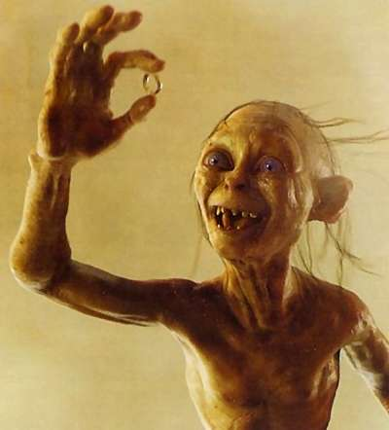
One function to rule them all
(define (foldr func base lst)
(if (null? lst) base
(func (car lst)
(foldr func base (cdr lst)))))
foldr

Slide 25
(foldr func base lst)
Say lst = '(1 2 3)
Foldr applies func repeatedly to pairs of items, starting from the right end of the list.
The first two items are the last item in the list and the base element.
The function must be a function of two items.
(f 1 (f 2 (f 3 base)))
In general, for lst = (x1 x2 … xn)
(f x1 (f x2 (f x3 (f … (f xn base)))…)

Slide 26
(define (sum-list-new lst)
(foldr + 0 lst))
(define (length-new lst)
(foldr (lambda (elt cdr-len) (+ 1 cdr-len)) 0 lst))
(define (my-map func lst)
(foldr (lambda (car cdr) (cons (func car) cdr)) '() lst))

